Slide 1
Midterm Presentation
Modeling and Simulation of Polymer Mechanical Properties
By: Vishakha Goyal (221199)

Slide 2
Index
Literature Review: Constitutive modeling of the large strain time-dependent behavior of elastomers
Hyperelasticity & Mooney Rivlin Model
Simulations & Curves - I
Literature Review: The mechanical behaviour of rubber under hydrostatic compression
Simulations & Curves - II

Slide 3
CONSTITUTIVE MODELING OF THE LARGE STRAIN TIME-DEPENDENT BEHAVIOR OF ELASTOMERS
J. S. BERGSTROM and M. C. BOYCE
Literature Review
Notes:
An elastomer is a polymer with viscoelasticity (i.e. both viscosity and elasticity) and with weak intermolecular forces, generally low Young's modulus (E) and high failure strain compared with other materials.
An elastomer is a polymer with viscoelasticity (i.e. both viscosity and elasticity) and with weak intermolecular forces, generally low Young's modulus (E) and high failure strain compared with other materials

Slide 4
Introduction
Elastomeric materials (e.g., rubbers) exhibit rate-dependent mechanical behavior:
Significant hysteresis during cyclic loading
Noteworthy time-dependent effects
Key Issues in Existing Models
Few models quantify the complex time-dependent and hysteretic responses
Equilibrium models: Primarily predict behavior under infinitely slow loading (classic rubber elasticity)
Time-dependent models: Scarce and often unable to capture the full spectrum of observed behaviors. Because parameters are typically not directly linked to physical structure, these models may perform poorly when applied to new conditions or materials
Aims of the Study
Experimental Investigation: Examine carbon black filled Chloroprene rubber under various loading and strain-rate histories

Slide 5
Experiments
Procedure
Mechanical tests were conducted on Chloroprene rubber with varying carbon black fillers, crosslinking densities, and unfilled Nitrile rubber as a reference.
Compression tests performed in two modes:
Uniaxial compression
Plane-strain compression
All experiments executed at room temperature on a computer-controlled Instron servo-hydraulic testing machine using strain control to minimize external compliance errors.
Each specimen underwent 5–6 pre-conditioning load cycles to a final strain of about -1 to eliminate the Mullins effect and ensure repeatability.
Loading paths included strain-rate sweeps (to probe rate-dependence) and relaxation segments (to probe relaxation), both during uploading and unloading phases

Slide 6
Experiments
Results
The material response becomes repeatable after the Mullins softening has been removed
Both filled and unfilled elastomers show significant amounts of hysteresis during cyclic loading, which is unrelated to the Mullins effect.
The carbon black particle content does not strongly influence the normalized amount of hysteresis (defined as the dissipated energy divided by supplied energy during the loading phase)
Both filled and unfilled elastomers displayed strong strain-rate dependence; notably, strain-rate effects were more pronounced during uploading than unloading.
At fixed strain, the stress is observed to approach the same equilibrium stress with relaxation time, whether loading or unloading.

Slide 7
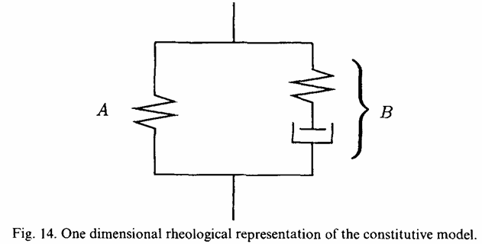
Constitutive Modeling
Based on experimental findings, the total mechanical response of the elastomer is modeled as two parallel polymer networks:
Equilibrium Response(A): Network A is a “perfect network” and can be modeled by any of the classical models based on hyperelasticity.
Time-dependent deviation from equilibrium(B): Network B is here modeled as a perfect network in series with a time-dependent element which acts to relieve the strain on the perfect network with time and capture the characteristics observed in the experimental investigation.

Slide 8
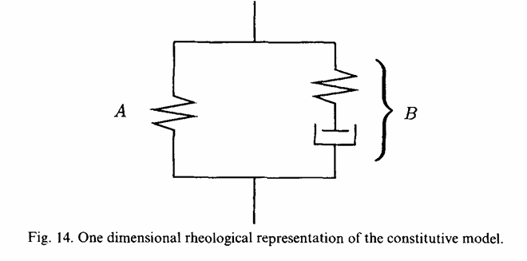
Constitutive Modeling
The experimental observation that the mechanical behavior can be decomposed into two parts: an equilibrium response and a time-dependent deviation from equilibrium, suggests that the material can be modeled as two polymer networks acting in parallel.
Network A is a “perfect network” and can be modeled by any of the classical models based on hyperelasticity.
Network B is here modeled as a perfect network in series with a time-dependent element that relieves the strain on the perfect network with time and captures the characteristics observed in the experimental investigation.

Slide 9
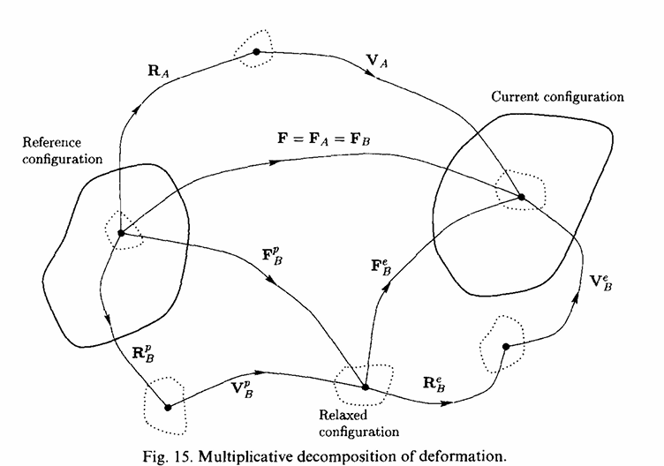
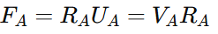
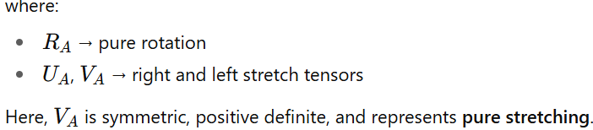
Finite strain kinematics & constitutive representation
The total deformation gradient tensor F tells us how each material point moves from its reference configuration to its current configuration.
Network A → represents the elastic (equilibrium) response.
Network B → includes both elastic and inelastic (viscous or plastic) effects.
Kinematics and constitutive representation of equilibrium behavior [Element (A)].
Polar Decomposition for Network A

Slide 10
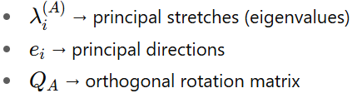
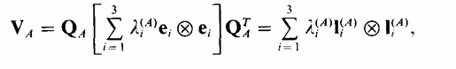
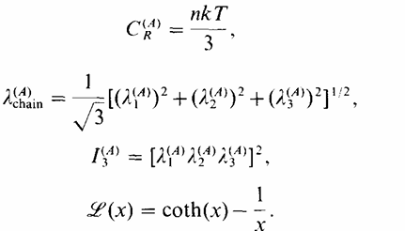
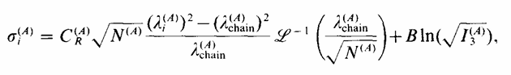
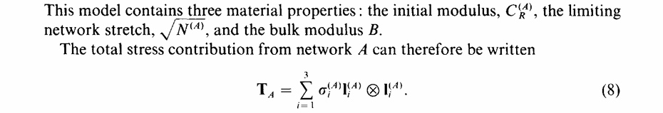
Spectral Representation of the Stretch
Stress in Network A – Arruda–Boyce Model: compressible eight-chain model

Slide 11
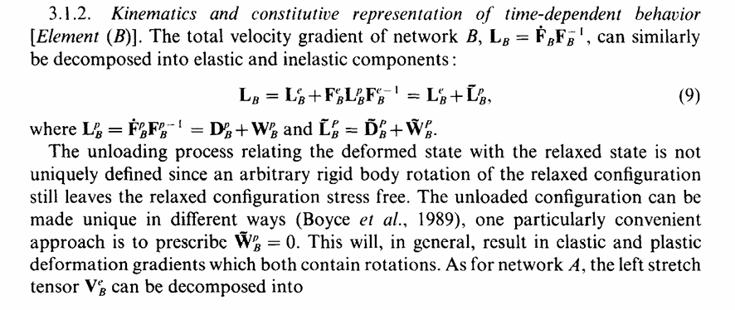
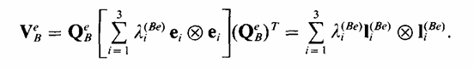

Slide 12
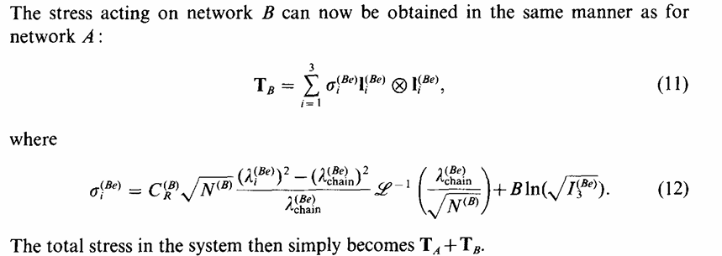
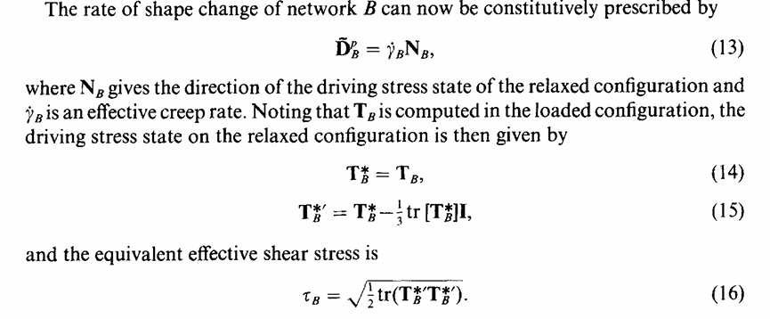

Slide 13
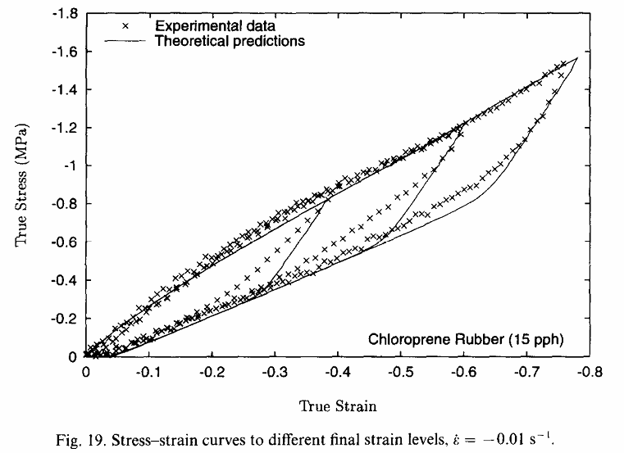
Results
The results from applying the proposed model to a uniaxial compression experiment with different final strain levels are shown in Fig. 19, illustrating that the model provides good quantitative predictions of the stress-strain behavior and hysteresis.

Slide 14
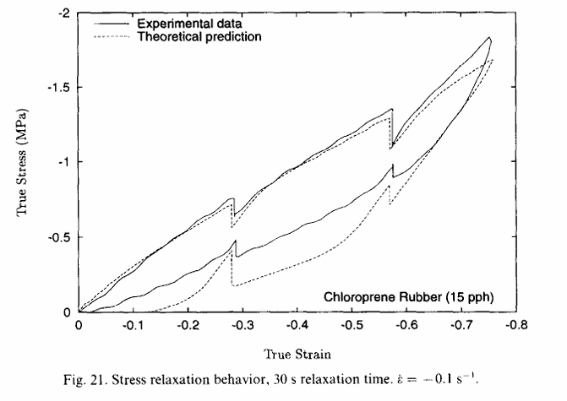
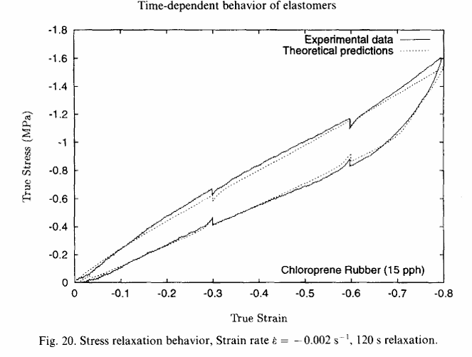
Results
The prediction of the combined constant strain-rate and relaxation test of this type is shown for two very different strain rates. These two figures indicate that the model predicts the slow strain-rate data very well during both uploading and unloading. However, for very high strain rates, the behavior during loading is well predicted, but the departure from equilibrium during unloading is not well predicted.

Slide 15
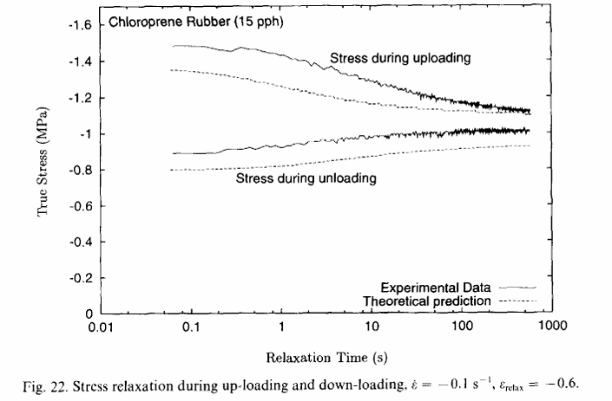
Results
The predicted rate of relaxation during both uploading and unloading at a strain rate of e = -0.1 ss’ and a strain of srelax = -0.6 is shown in Fig. 22. This figure shows that the predicted stress relaxation rate is in good agreement with the experimental data, also note how fast the relaxation rate decreases with relaxation time.

Slide 16
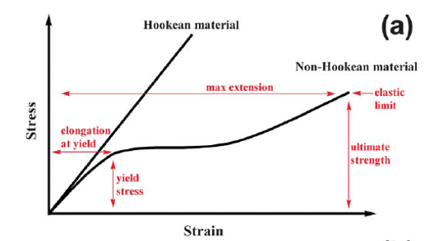
Hyperelasticity
Hyperelastic materials show a non-linear stress-strain relationship, meaning their deformation isn’t directly proportional to the applied force, even when they return to their original shape.
Hyperelasticity is used to model materials that can undergo large, reversible deformations, such as rubbers, elastomers, and soft tissues.
Hyperelastic materials use something called a strain energy density function to derive the relationship between stress and strain. This allows them to model the relationship between stress and strain accurately, even when the strain is between 100% to 700%, depending on the exact hyperelastic model that is used.

Slide 17
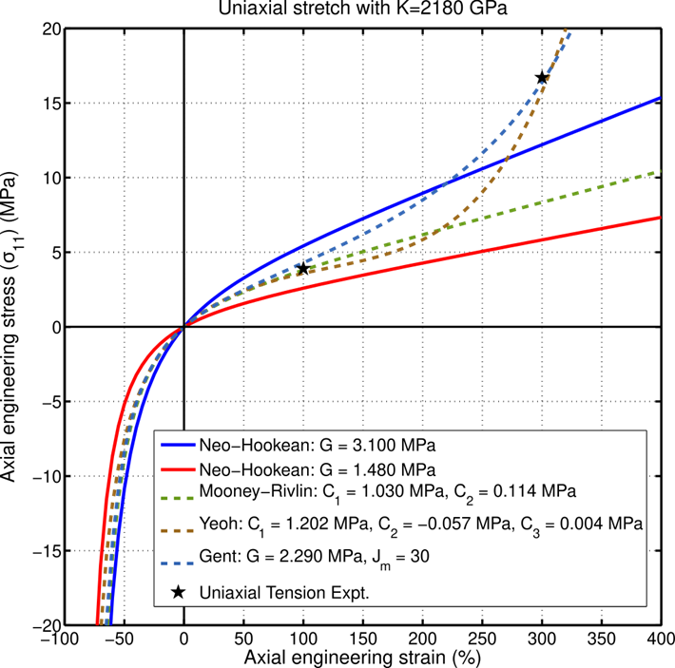
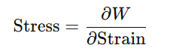
Hyperelasticity
Instead of defining stress directly as a function of strain, we define a strain energy density function W (energy stored per unit volume).
From W, the stress is derived mathematically:
Different forms of W lead to different hyperelastic material models.
Common models:
Neo-Hookean model – simplest, often used for rubber-like materials.
Mooney–Rivlin model – more accurate for large strains.
Ogden model – fits a wider range of experimental data, especially for biological tissues.
Stress–strain curves for various hyperelastic material models.

Slide 18
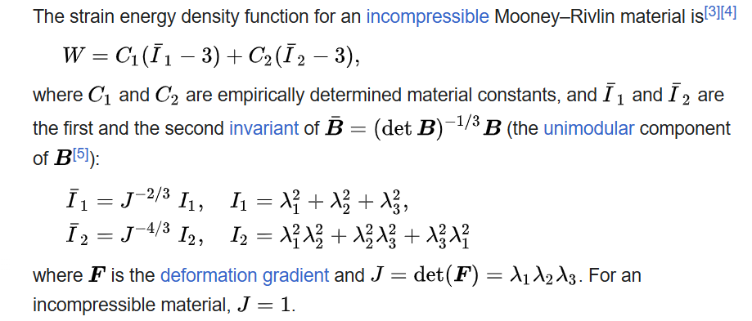
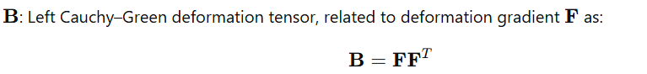
Mooney-Rivlin Model
In continuum mechanics, a Mooney–Rivlin solid is a hyperelastic material model where the strain energy density function W is a linear combination of two invariants of the left Cauchy–Green deformation tensor B.
I1​ tells you how much it’s stretched overall.
I2​ tells you how the stretches in different directions interact.

Slide 19
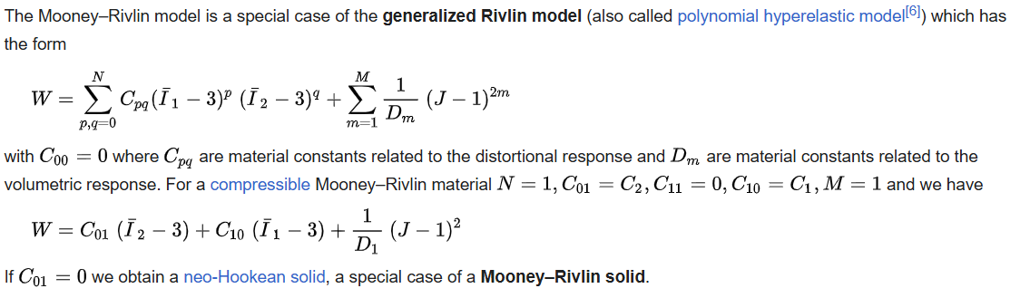
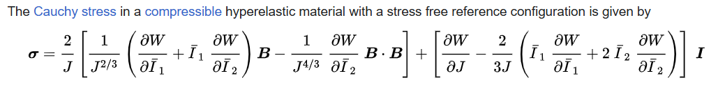
Derivation
Cauchy stress in terms of strain invariants and deformation tensors

Slide 20
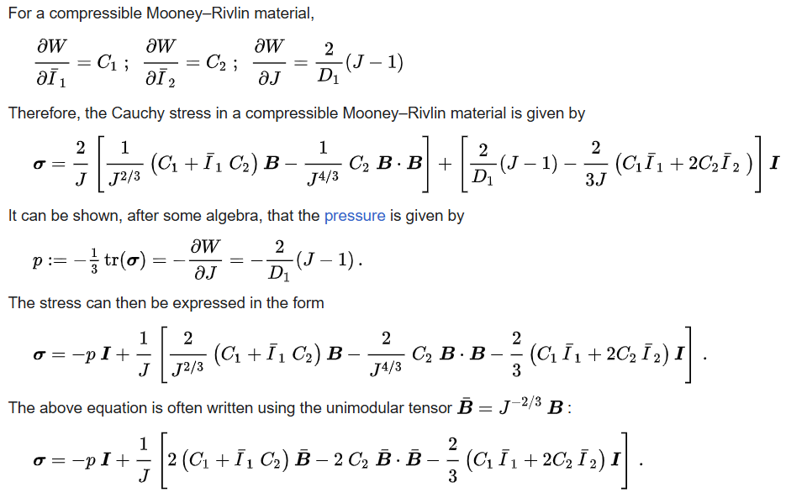
Cauchy stress in terms of strain invariants and deformation tensors

Slide 21
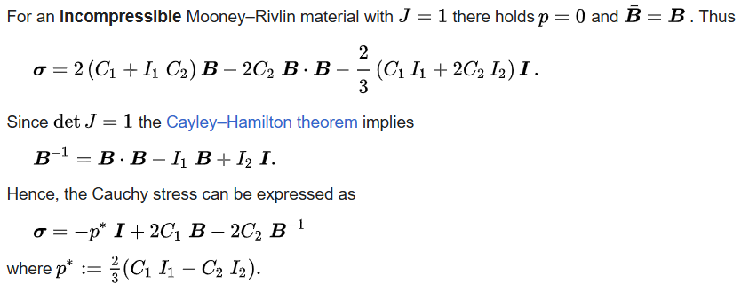
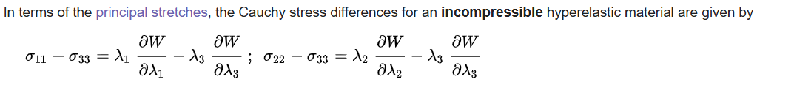
Cauchy stress in terms of strain invariants and deformation tensors
Cauchy stress in terms of principal stretches

Slide 22
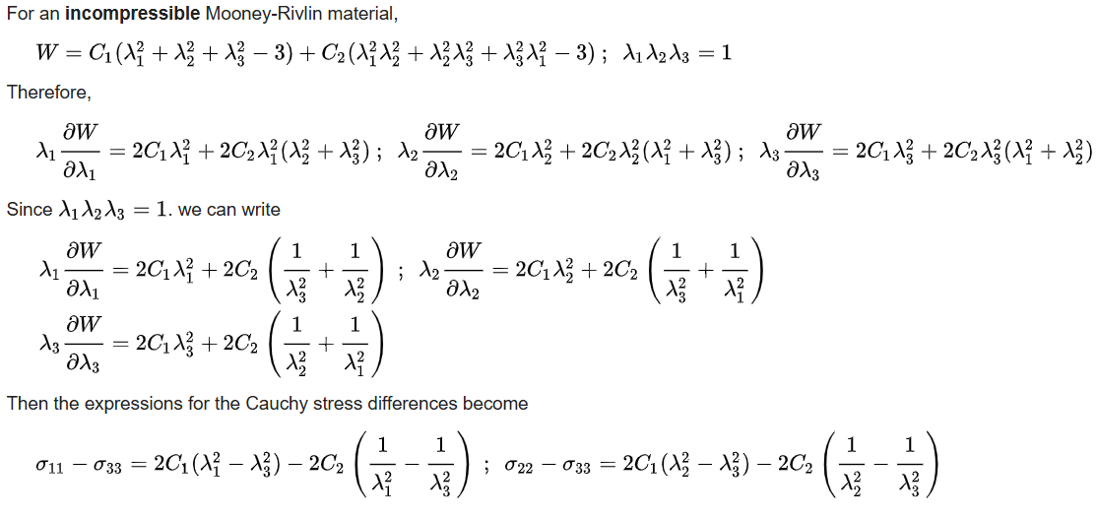
Cauchy stress in terms of principal stretches

Slide 23
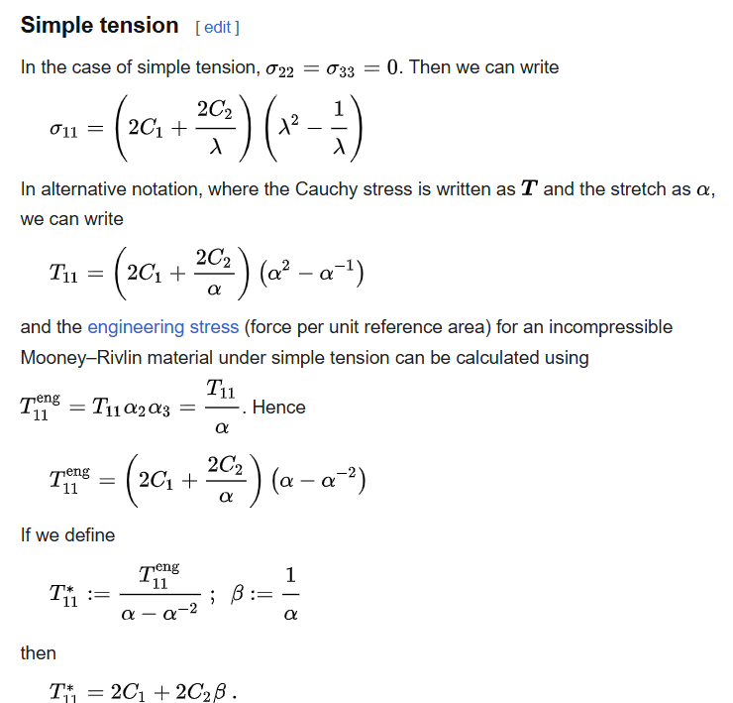
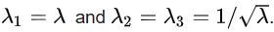
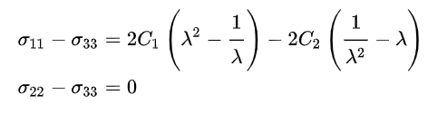
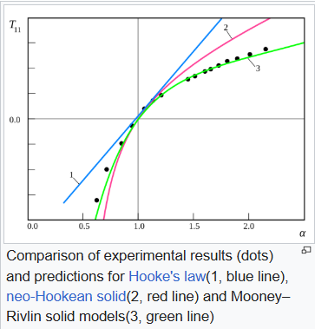
Uniaxial extension
For the case of an incompressible Mooney–Rivlin material under uniaxial elongation,
Then the true stress (Cauchy stress) differences can be calculated as:
Comparison of experimental results (dots) and predictions for Hooke's law(1, blue line), neo-Hookean solid(2, red line), and Mooney–Rivlin solid models(3, green line)

Slide 24
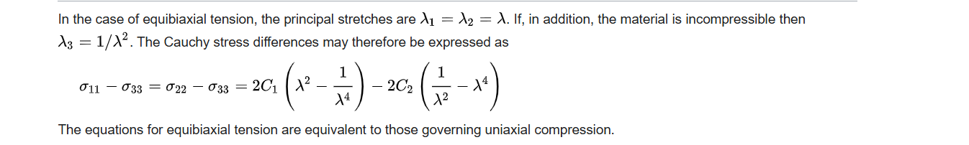
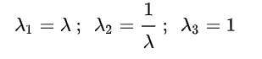
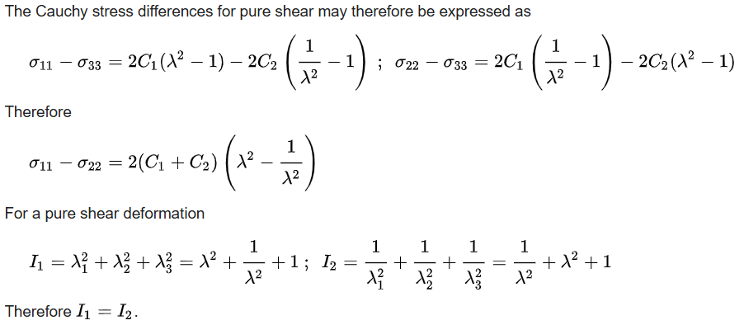
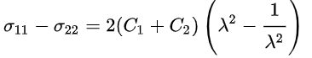
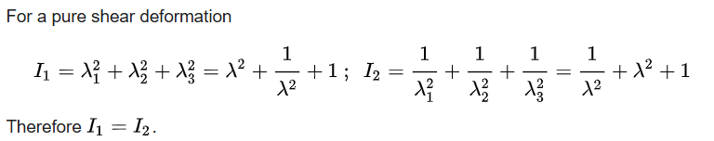
Equi-biaxial tension
Pure shear
A pure shear deformation can be achieved by applying stretches of the form
For a pure shear deformation

Slide 25
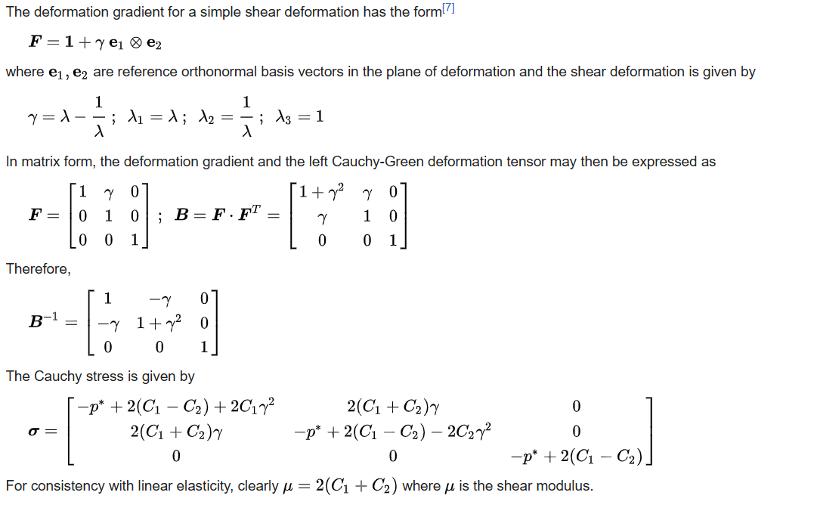
Simple shear

Slide 26
Simulations & Curves-I
Mooney Rivlin & Polynomial

Slide 27
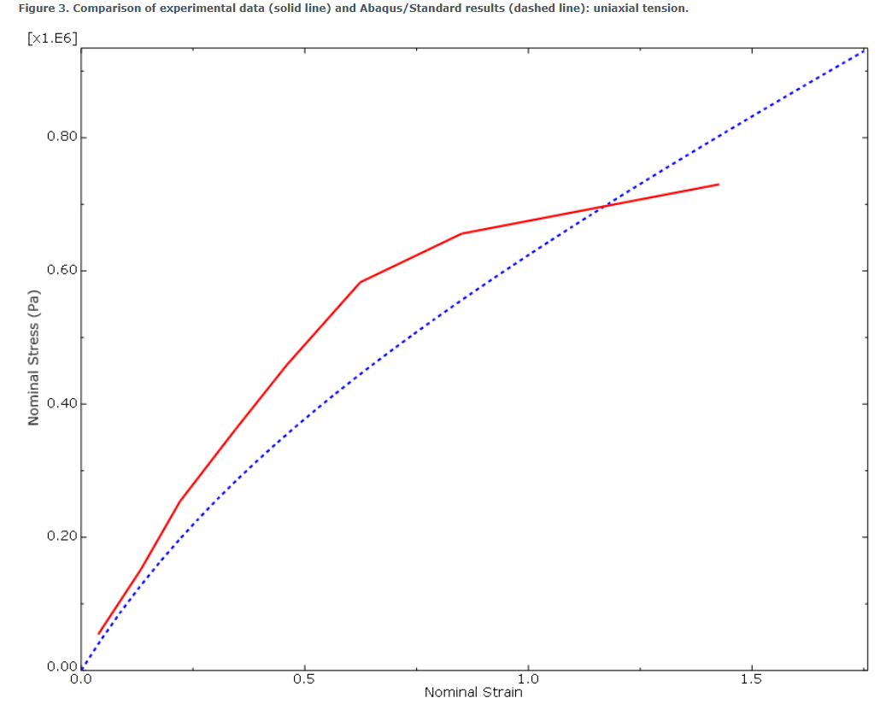
Test Data
The stress vs strain curve:
Linear for low strain values
https://abaqus.uclouvain.be/English/SIMACAEGSARefMap/simagsa-t-materialpropertieshyperelasticmodelfortherubber.htm

Slide 28
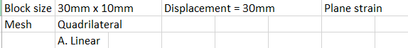
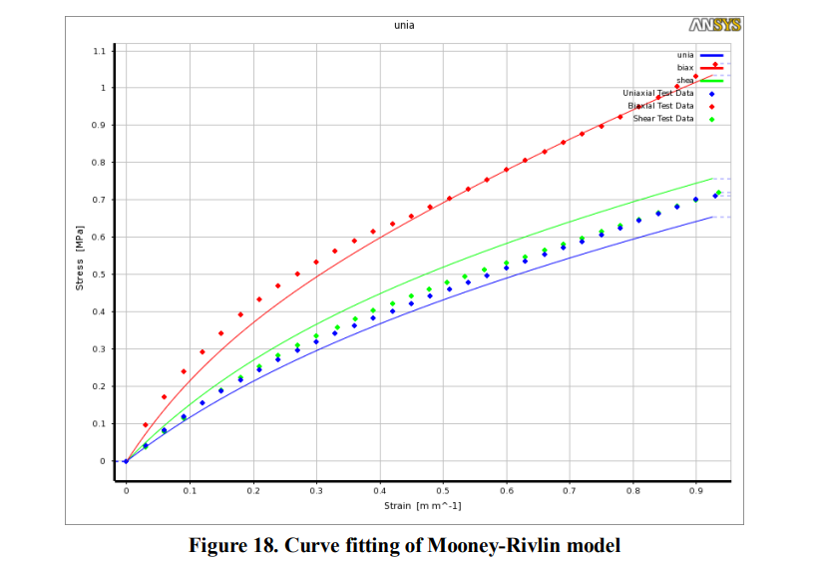
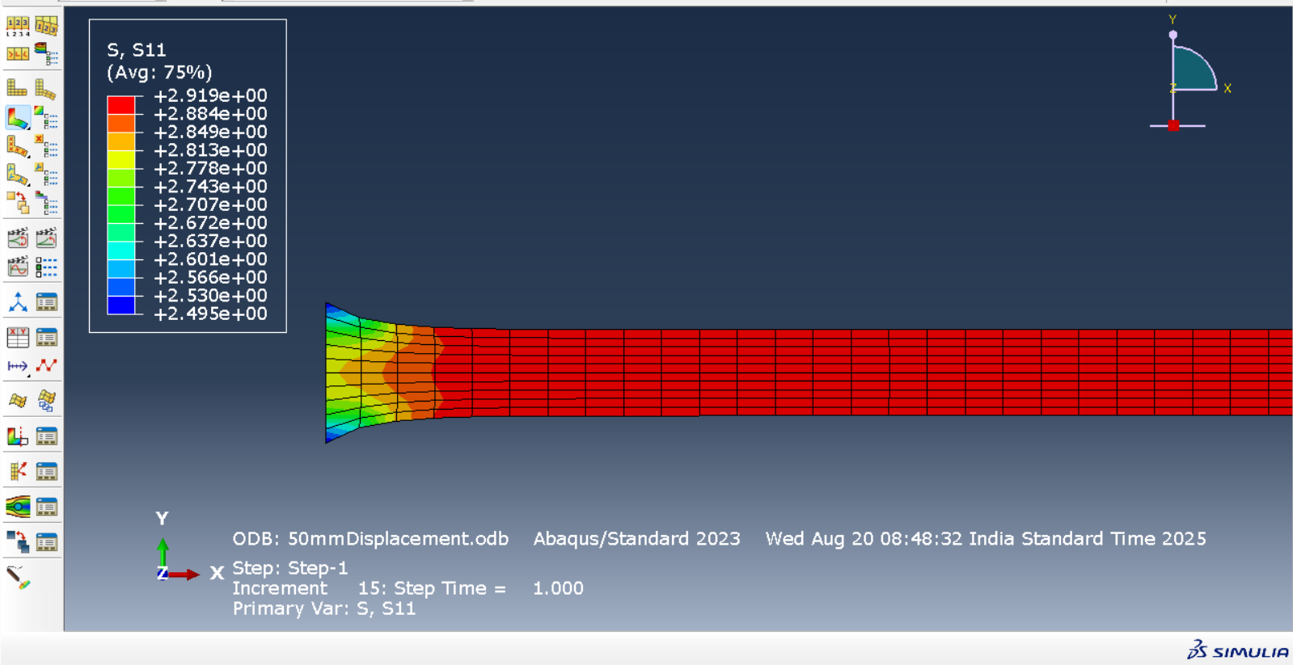
Simulate uniaxial stress for the Mooney Rivlin solid on ABAQUS
Obtained the same results for the quadrilateral mesh with quadratic order and the triangular mesh with both linear and quadratic order.
Alternate reference to graph between stress and strain
Sugihardjo, Hidajat & Tavio, Tavio & Lesmana, Yudha. (2018). FE Model of Low Grade Rubber for Modeling Housing’s Low-Cost Rubber Base Isolators. Civil Engineering Journal. 4. 24. 10.28991/cej-030966.

Slide 29
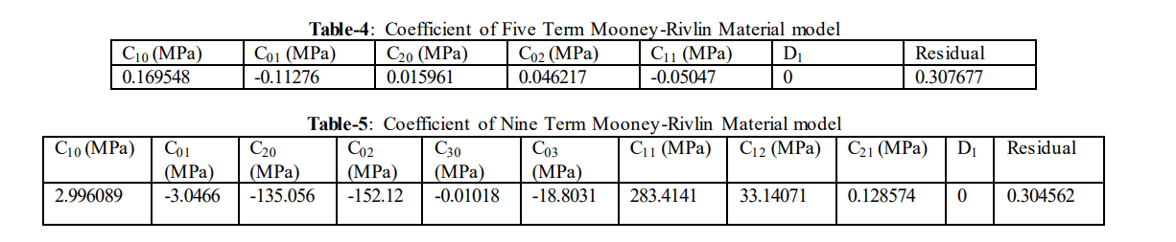
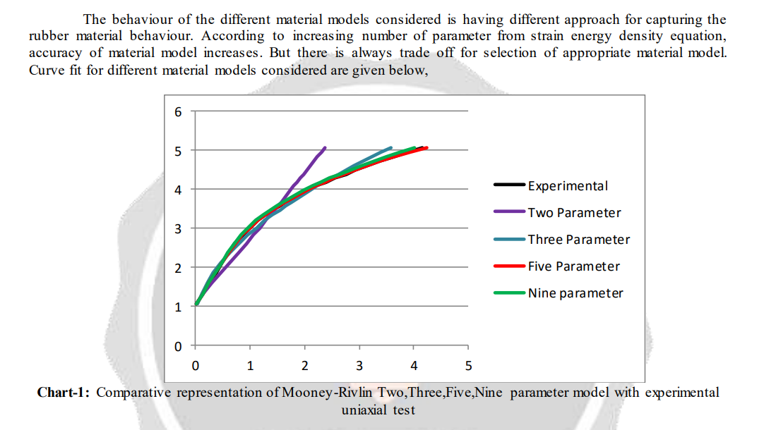
Test Data
> Tried putting coefficients instead of uniaxial test data.
https://scispace.com/pdf/comparative-study-of-variation-of-mooney-rivlin-hyperelastic-3e97pfpngh.pdf
Notes:
Papers had:
Sugihardjo, Hidajat & Tavio, Tavio & Lesmana, Yudha. (2018). FE Model of Low Grade Rubber for Modeling Housing’s Low-Cost Rubber Base Isolators. Civil Engineering Journal. 4. 24. 10.28991/cej-030966. https://civilejournal.org/index.php/cej/article/view/613/pdf
https://abaqus.uclouvain.be/English/SIMACAEGSARefMap/simagsa-t-materialpropertieshyperelasticmodelfortherubber.htm

Slide 30
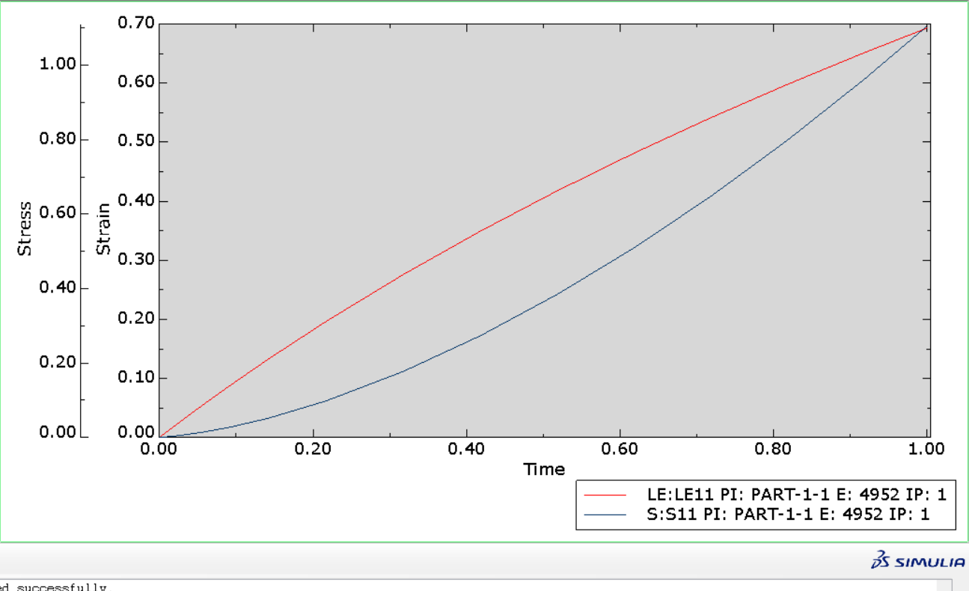
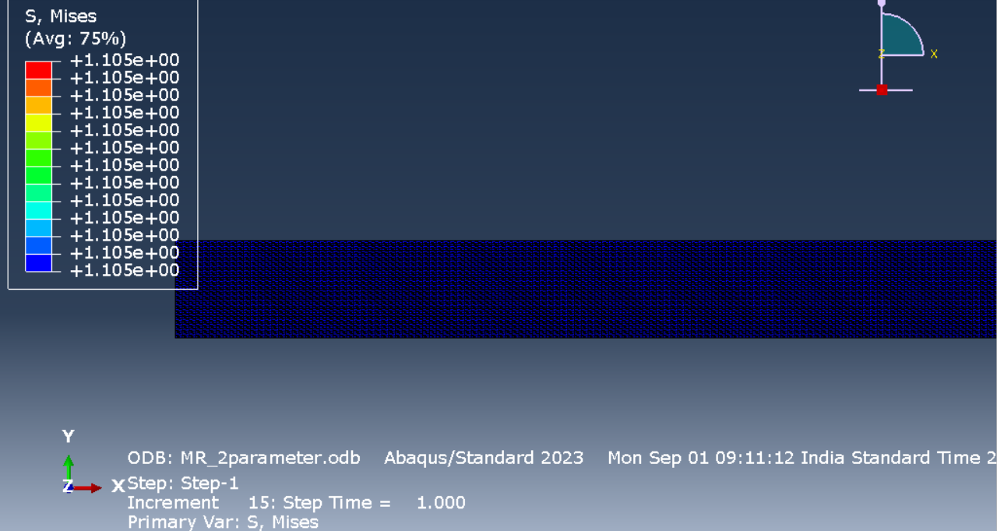
Mooney Rivlin – 2 parameters
Strain | Stress (MPa)
0 | 0
0.00995 | 0.001845
0.019803 | 0.003993
0.034401 | 0.007764
0.055908 | 0.014606
0.087324 | 0.027378
0.132672 | 0.051734
0.197056 | 0.098742
0.275973 | 0.177485
0.349115 | 0.27309
0.41727 | 0.383905
0.481075 | 0.508827
0.541052 | 0.6471
0.597634 | 0.798196
0.651185 | 0.96174
0.693147 | 1.10528
Setup:
Plane stress, Triangular Mesh, Dimensions of block = 30mmX10mm, Displacement = 30mm

Slide 31
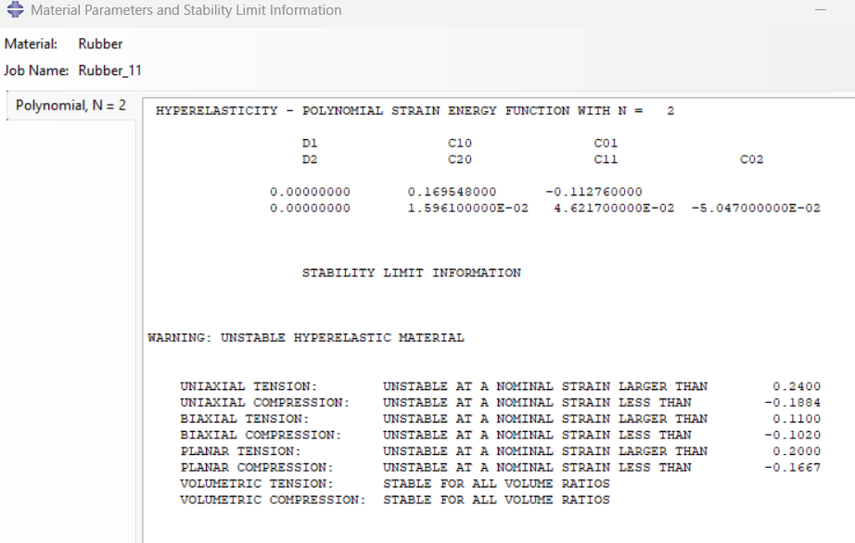
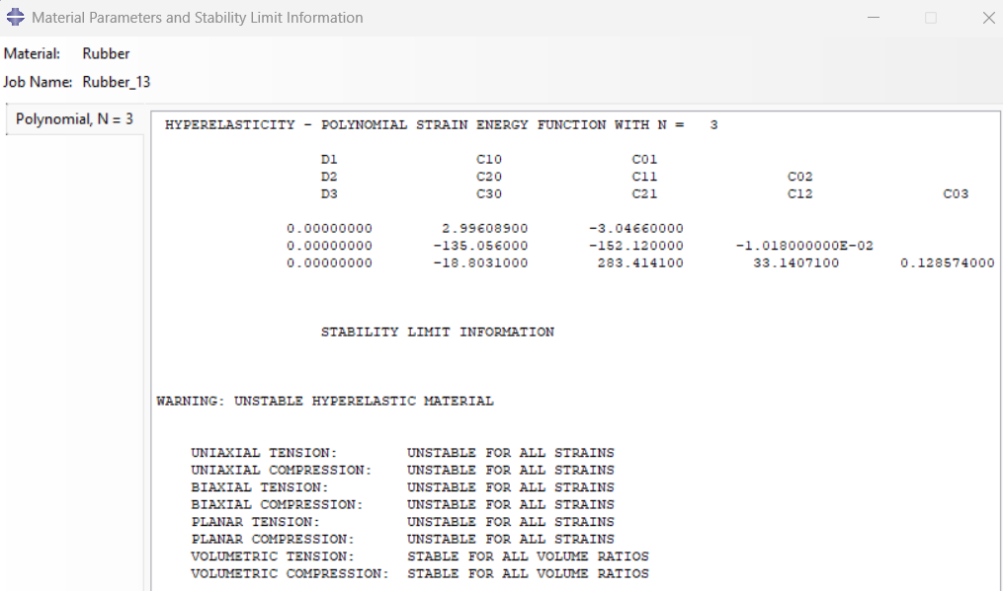
Polynomial – 5&9 parameters
The option for strain energy potential order other than one is unavailable under Mooney Rivlin in Abaqus. Hence, used the polynomial.
The two-term and three-term data were unstable for the polynomial model, hence simulated for the 5-term model and 9-term model.

Slide 32
Polynomial – 5 parameters
Polynomial – 9 parameters
Strain | Stress
0 | 0
0.00995 | 0.001845
0.019803 | 0.003993
0.034401 | 0.007764
0.055908 | 0.014606
0.087324 | 0.027378
0.132672 | 0.051734
0.197056 | 0.098742
0.275973 | 0.177485
0.349115 | 0.27309
0.41727 | 0.383905
0.481075 | 0.508827
0.541052 | 0.6471
0.597634 | 0.798196
0.651185 | 0.96174
0.693147 | 1.10528
Strain | Stress
0 | 0
0.00995 | -0.01144
0.019803 | -0.07968
0.034401 | -0.41358
0.055908 | -1.78396
0.087324 | -6.79602
0.132672 | -23.3698
0.197056 | -71.4993
0.275973 | -165.413
0.349115 | -244.066
0.41727 | -212.909
0.481075 | 64.1655
0.541052 | 764.389
0.597634 | 2106.44
0.651185 | 4351.27
0.693147 | 7085.1
The same stress-strain curve was obtained as for the Mooney Rivlin

Slide 33
The mechanical behaviour of rubber under hydrostatic compression and the effect on the results of finite element analyses
Literature Review
Jan Zimmermann · Markus Stommel
Zimmermann, Jan & Stommel, Markus. (2013). The mechanical behaviour of rubber under hydrostatic compression and the effect on the results of finite element analyses. Archive of Applied Mechanics. 83. 10.1007/s00419-012-0655-z.

Slide 34
Aim
1. Proving validity by determining the mechanical behaviour of NR under hydrostatic pressure.
Assumption: In FE simulations, a split of the strain energy function takes place, splitting stresses into a deviatoric and a volumetric part.
2. To determine the bulk modulus of Natural rubber and its effects on the simulation results of a bearing.
The obtained results are compared to test data to show the bulk modulus is an important material parameter to optimise the quality of the simulation results achieved by hyperelastic material models in finite element analyses
Introduction
Models applied to hyperelastic materials are :
Based on a strain energy density function, for example, Mooney-Rivlin, Ogden
Molecular-statistical approaches, for example, Arruda-Boyce, Kilian.
Usual assumptions taken:
Incompressible material behaviour
Setting the bulk modulus K to a constant value, which is several orders of magnitude higher than the applied shear modulus.
This offers a satisfactory outcome quality for most of the technical applications of rubber, since they are not dealing with higher hydrostatic pressure values up to several 100 bar.
However, a large deviation between simulation results and the components’ real-life behaviour of characteristics like material stiffness, dependent on the approximated bulk modulus, is obtained.

Slide 35
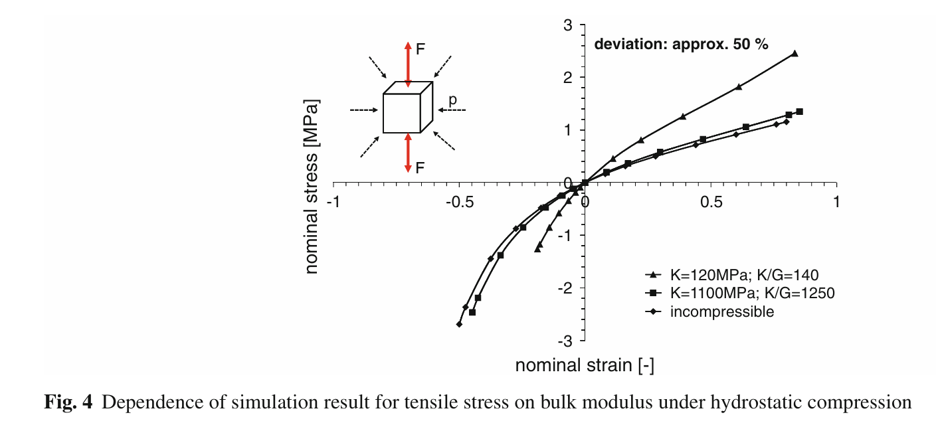

But when conducting the same simulation on specimens under hydrostatic pressure, the results deviate considerably, even though every chosen value of the bulk modulus fulfils the condition of being orders of magnitude higher than the shear modulus.
In Fig. 3, the simulation results of a unidirectional compression and tensile test for different values of the bulk modulus are compared to the results obtained by assuming incompressibility.
There is no significant deviation between the resulting stresses, and hence no dependence on the bulk modulus.
Fig. 4 shows the dependence of the nominal stress on the bulk modulus for a natural rubber in tensile and compression tests on a rubber component under a constant hydrostatic pressure of 300 bar.

Slide 36



Assumption: Material models based on a strain energy density function assume a split of the respective function into two parts,
The deviatoric, incompressible deformation covers the isochoric change in shape due to the applied load.
The volume-changing deformation is dependent on the hydrostatic pressure.
In the present paper, the validity of these assumptions is examined.
Notes:
Deviatoric" comes from deviator, meaning the part of stress or strain that causes shape change without volume change
So isochoric deformation = deformation at constant volume.
In rubber mechanics, we often assume that rubber is nearly incompressible, so most of its deformation is isochoric

Slide 37

2. Test bench

Slide 38


3. Results
The tests were conducted for a technical NR with a hardness of 56 Shore A.
Test specimens used: 2 mm thickness, cross-sectional area of 16 mm2.
Hydrostatic pressure values = 1, 100, 200, and 300 bar.
3.1 Tensile tests
Confirmed the assumption that there is no influence of hydrostatic pressure up to 300 bar on the deviatoric behaviour of an NR for stretches up to 80 %.
Since the influence of hydrostatic pressure has proved negligible, the split of the strain energy function is valid for the investigated NR.
This enables the determination of the Cauchy stress as follows:

Slide 39


3.2 Hydrostatic compression tests
where λ1 = λ2 = λ3 < 1, in the previous Cauchy stress calculation.
The specimen is cylindrically shaped with a length of 100 mm and a diameter of 18 mm.
The bulk modulus of the tested rubber specimen corresponds to the slope of the displayed graph.
Due to the low pressure values, this results in an approximated bulk modulus, which corresponds to the initial value of the gradient, of
Several further tests using other types of rubber and shore hardness show the same effect:
a slight increase in curvature followed by a nearly linear relationship between volume change and hydrostatic pressure for higher volume ratios. There is an increase in the bulk modulus of about one order of magnitude.
Thus, the bulk modulus is an important feature to influence the outcome quality of FE simulations, especially for rubber components that are partially or completely exposed to hydrostatic pressure.

Slide 40




Since in the hydrostatic compression test only very small uniform strains occur, in contrast to mechanical tests (e.g., uniaxial tensile testing), the material behaviour under hydrostatic compression enables the approximation of the Poisson ratio (see Fig. 8) according to Krevelen as follows:
For hydrostatic pressure values greater than 4 MPa, the Poisson ratio is nearly constant at 0.49992, which again clearly indicates the compressibility of the rubber component.
3.3 Comparison of test results with FE simulations
μ =1.08(initial shear modulus);
λm = 5.92(locking stretch);
α = 0.18(global interaction parameter);
β = 0 (linear mixture parameter);
Ii = invariants of the Cauchy–Green tensor;
J = total volume change

Slide 41

3.4 Comparison of tensile tests
A simple tensile test under normal pressure is simulated using two different settings.
At first, the rubber is assumed to be incompressible, which means the volumetric part of the strain energy function is neglected.
The second simulation is conducted with an assumed bulk modulus of 120 MPa.
As shown in Fig. 9, the deviation between the simulation results and the test data is negligible.
compression.
That means the assumption of incompressibility is valid, provided that the hydrostatic pressure values are sufficiently low. In this case, there is no significant influence of the bulk modulus on the tensile behaviour of these rubber components. The limitation of this assumption depends on the rubber used and its behaviour under hydrostatic

Slide 42

In a second step, according to the test conducted, simulations on a rubber component under a hydrostatic pressure of 300bar were carried out.
Viscoelastic effects are neglected in this comparison.
Instead of assuming an incompressible material behaviour, a bulk modulus of 2,500 MPa is chosen.
The results shown in Fig. 10 emphasise the importance of the knowledge of the exact volumetric behaviour of rubber in simulating rubber components exposed to higher hydrostatic pressure values.

Slide 43

3.5 Influence on the simulation of confined rubber components
A bushing, as a practical rubber component, partially exposed to hydrostatic pressure up to 30 MPa, is used
This kind of bushing is used in automotive vehicles and significantly influences their road handling.
A crucial parameter is the material stiffness, which is determined in mechanical tests on the bushing under different load cases, such as radial or axial deflection, or torsion.
The material stiffness corresponds to the required reaction force to realise the radial deflection and serves as an indicator for the simulation outcome quality.
Notes:
A bushing is a cylindrical lining or component used in two main contexts: to reduce friction and wear between moving parts in mechanical systems, or to provide electrical insulation for a conductor passing through a conductive barrier. Mechanical bushings, also known as sleeve bearings, are typically made of low-friction materials like bronze or plastic, while electrical bushings are made of insulating materials such as porcelain or steatite.

Slide 44
Simulations & Curves - II
Mooney Rivlin with pressure applied

Slide 45

For pressure as 0.1MPa
Strain | Stress
0 | 0
7.04E-05 | 0.0001
0.000141 | 0.0002
0.000246 | 0.00035
0.000405 | 0.000575
0.000643 | 0.000913
0.000999 | 0.001419
0.001534 | 0.00218
0.002337 | 0.003321
0.003541 | 0.005035
0.005349 | 0.007609
0.008062 | 0.011479
0.012135 | 0.017304
0.018254 | 0.026086
0.025341 | 0.036306
0.03244 | 0.046599
0.039552 | 0.056965
0.046674 | 0.067404
0.053806 | 0.077917
0.060946 | 0.088505
0.068095 | 0.099168
0.071065 | 0.103617
Straight line as expected for strain values less than 0.2
For P=1MPa, ran only till 0.4 MPa stress

Slide 46

Run for low P values like 0.4 MPa with a quadratic mesh and increase no of increment steps
P=-0.5MPa
Strain | Stress
0 | 0
0.00325 | 0.01
0.00656 | 0.02
0.01154 | 0.035
0.01906 | 0.0575
0.03044 | 0.09125
0.04772 | 0.14188
0.06525 | 0.1925
0.08304 | 0.24313
0.09165 | 0.26844
0.09614 | 0.28109
0.10066 | 0.29375
0.10519 | 0.30641
0.10974 | 0.31906
0.1143 | 0.33172
0.11487 | 0.3333
0.11543 | 0.33488
0.11558 | 0.33528
0.11579 | 0.33587
0.11611 | 0.33676
For higher values, 1MPa doesn’t run because it runs for more than 2 hrs, and the ABAQUS license gets disconnected.
For lower values of P applied: The curve is a straight line similar to 0.4MPa
The strain reached only 0.11611 for 0.4MPa
This is not in agreement with the test data as well.
Need higher values of strain to compare the change of slope.

Slide 47

Test data being used till now:
Uniaxial test data
Strain | Stress
0.038 | 0.054
0.1338 | 0.152
0.221 | 0.254
0.345 | 0.362
0.46 | 0.459
0.6242 | 0.583
0.851 | 0.656
1.4268 | 0.73
https://abaqus.uclouvain.be/English/SIMACAEGSARefMap/simagsa-tmaterialpropertieshyperelasticmodelfortherubber.htm

Slide 48



https://iopscience.iop.org/article/10.1088/1757-899X/888/1/012065/pdf

Slide 49


Stable for Polynomial n=2
and Odgen n=3

Slide 50


Slide 51
Size of block = 30mm x 10 mm
Displacement = 30 mm
N=2 Polynomial
Strain | Stress
0 | 0
0.001 | 0.00678
0.002 | 0.01353
0.00349 | 0.0236
0.00573 | 0.03857
0.00908 | 0.06077
0.01409 | 0.09347
0.02155 | 0.14125
0.03263 | 0.21028
0.04904 | 0.30851
0.07315 | 0.44587
0.10825 | 0.63509
0.15871 | 0.89624
0.22992 | 1.2739
0.32804 | 1.88859
0.45923 | 3.06346
0.6285 | 5.62607
0.69315 | 7.06411
Odgen | N=3
Strain | Stress
0 | 0
0.001 | 0.00685
0.002 | 0.01367
0.00349 | 0.02383
0.00573 | 0.03894
0.00908 | 0.06131
0.01409 | 0.09423
0.02155 | 0.14225
0.03263 | 0.21143
0.04904 | 0.30958
0.07315 | 0.44635
0.10825 | 0.63424
0.15871 | 0.8936
0.22992 | 1.27038
0.32804 | 1.88758
0.45923 | 3.06823
0.6285 | 5.6317
0.69315 | 7.06652

Slide 52

Doesn’t correspond to the test data, as stress values are very high even for small strain
Old comparison data is the Mooney Rivlin model with previous test data.

Slide 53

Hydrostatic condition
Pinned (u1=u2=u3=0)
Displacement =30mm

Slide 54
New corresponds to the new test data from: https://iopscience.iop.org/article/10.1088/1757-899X/888/1/012065/pdf

Slide 55
Thank You!
Date: 19 September 2025

Slide 56

Apply compression instead of stretch to get the graph in the third quadrant: after midterm
Stress (MPa) | Strain
0.2924 | 0.0492
0.5848 | 0.1204
0.8772 | 0.2133
1.1696 | 0.3167
1.462 | 0.4215
1.7544 | 0.5236
2.0468 | 0.6093
2.3392 | 0.7
2.6316 | 0.7787
2.924 | 0.8557
3.2164 | 0.9303
3.5088 | 0.9992
3.8012 | 1.0654
4.0936 | 1.1282
4.386 | 1.1913
4.6784 | 1.2484
4.9708 | 1.3033
5.2632 | 1.3605
5.5556 | 1.4115
5.848 | 1.4685
6.1404 | 1.5199
6.4327 | 1.5709
6.7251 | 1.6205
7.0175 | 1.6694
7.3099 | 1.7155
7.6023 | 1.7638
7.8947 | 1.8143
8.1871 | 1.8624
8.4795 | 1.9091
8.7719 | 1.9561
9.0643 | 2.0022
9.3567 | 2.0496
9.6491 | 2.098
9.9415 | 2.1466
10.2339 | 2.1937
10.4094 | 2.2312
Test data: Stable for Odgen N=1
https://iopscience.iop.org/article/10.1088/1757-899X/888/1/012065/pdf

Slide 57



Getting stress vs strain curves for displacement (without hydrostatic conditions): Compression
Displacement:15mm compression
Size 30mmX10mm
Mesh Controls: Quad elements, linear, hybrid formulation

Slide 58



Getting stress vs strain curves for displacement (without hydrostatic conditions) : Tension
Displacement: 80mm tension
Size 30mmX10mm
Mesh Controls: Quad elements, linear, hybrid formulation

Slide 59


Slide 60



Next, applying the hydrostatic conditions with tension
Displacement:30mm stretch
Size 30mmX10mm
Mesh Controls: Quad elements, linear, hybrid formulation

Slide 61



Next, applying the hydrostatic conditions with compression
Displacement:15mm compression
Size 30mmX10mm
Mesh Controls: Quad elements, linear, hybrid formulation

Slide 62


